Slide 1

Basics of Neural Network Programming
Derivatives
deeplearning.ai
Notes:
1

Slide 2
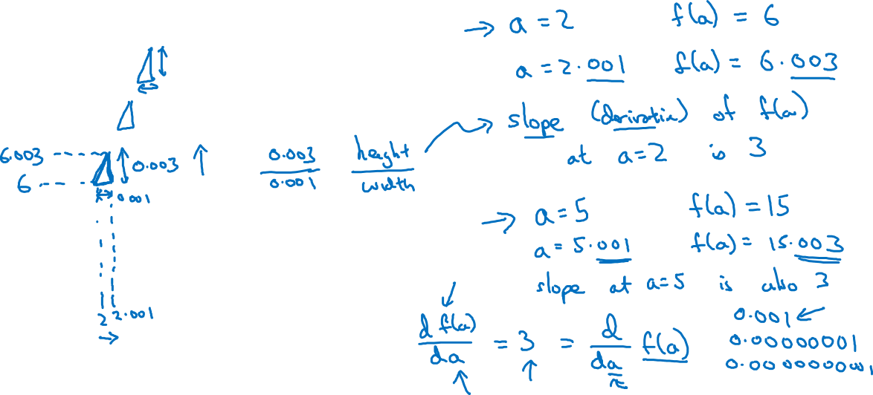


Intuition about derivatives
$a$

Slide 3
Basics of Neural Network Programming
More derivatives examples
deeplearning.ai
Notes:
1

Slide 4
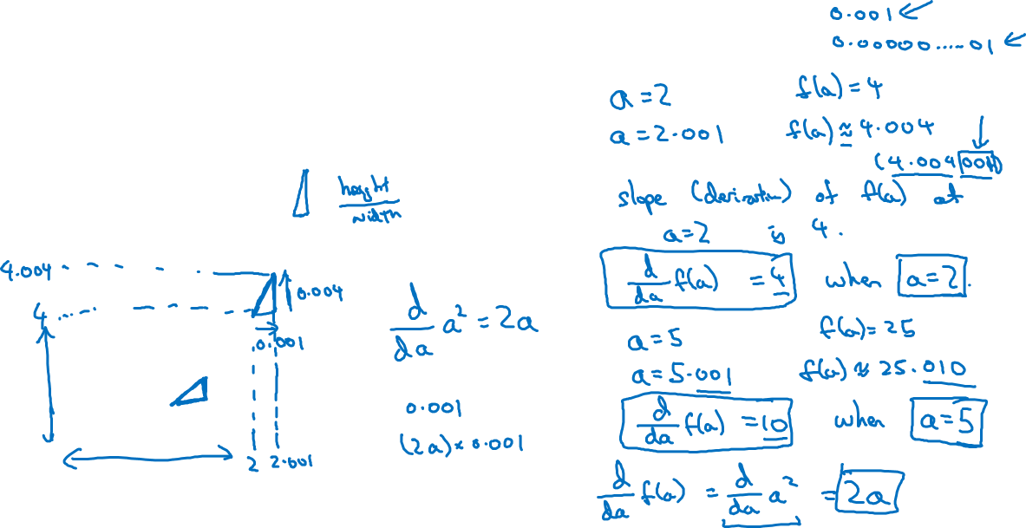

Intuition about derivatives
$a$

Slide 5
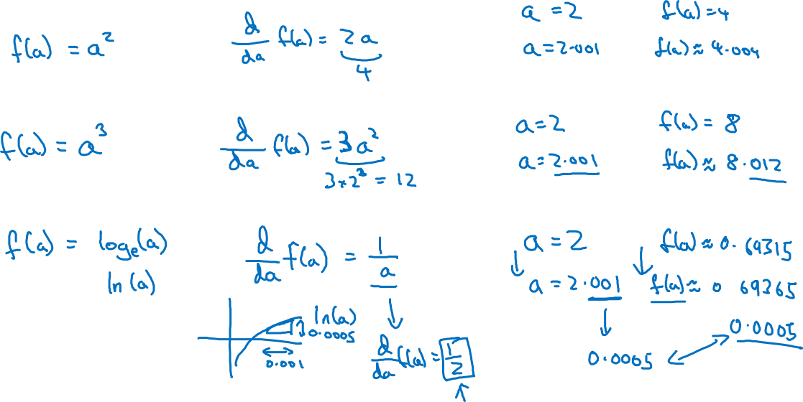
More derivative examples

